Slide 1
Outline
Monthly Mean Climatologies
Tropospheric and Stratospheric Ozone Climatologies
Information of the procedure, data available, and other things
Sample snapshots of grids made with Basemap and matplotlib
More sample vertical cross sections
Discrepancies existing in the climatologies
Background Information
Samples of Tropospheric and Stratospheric Ozone
Preliminary Results
Analysis of surface ozone and cross sectioned stratospheric intrusion
Analysis of Western lateral boundary conditions
Next Steps

Slide 2
Monthly Mean Climatologies with MACC Reanalysis Data
Diane Pendlebury
Ali Hasan

Slide 3
Information
Global
Grid data obtained from ECMWF
Based on MACC Reanalysis dataset
Resolution of 1.125° x 1.125° (320 longitudinal grid points, 161 latitudinal grid points)
Interpolated to 59 constant pressure levels, from 1000 hPa to 0.1 hPa
Available in FST format
/space/hall1/sitestore/eccc/aq/r1/alh002/FST_STORAGE
Format is “output_file_xxMONTH.fst” where xx is integer of month, starting at 01

Slide 4
Available Species
Species and parameters available are:
GEMS Ozone
Carbon Monoxide
Methane
Three dust aerosol bins
0.03 - 0.55 μm
0.55 - 0.90 μm
0.90 - 20.0 μm
Formaldehyde
Nitrogen Oxides
Sulphate Aerosol bin
Sulphur Dioxide
Specific Humidity*
Units are uniformly kg * kg⁻¹
*not plotted

Slide 5
NCDF Specifications & Directories
Each NCDF file contains ECMWF defined parameters.
Definitions can be found at the ECMWF Parameter database
The files are defined over 60 levels
Information found here
Species data used to create the FST files can be found at
/space/hall1/sitestore/eccc/aq/r1/alh002/NCDF/SPECIES/
They’re separated by parameter name (as defined by ECMWF) and each file is separated by year, and each dataset is defined globally
There also exists natural logarithm of surface pressure data at
/space/hall1/sitestore/eccc/aq/r1/alh002/NCDF/LNSP/
Also acquired but unused in these monthly mean climatologies was momentum data, found at
/space/hall1/sitestore/eccc/aq/r1/alh002/NCDF/MOMFILES/

Slide 6
Here are some figures over April

Slide 7
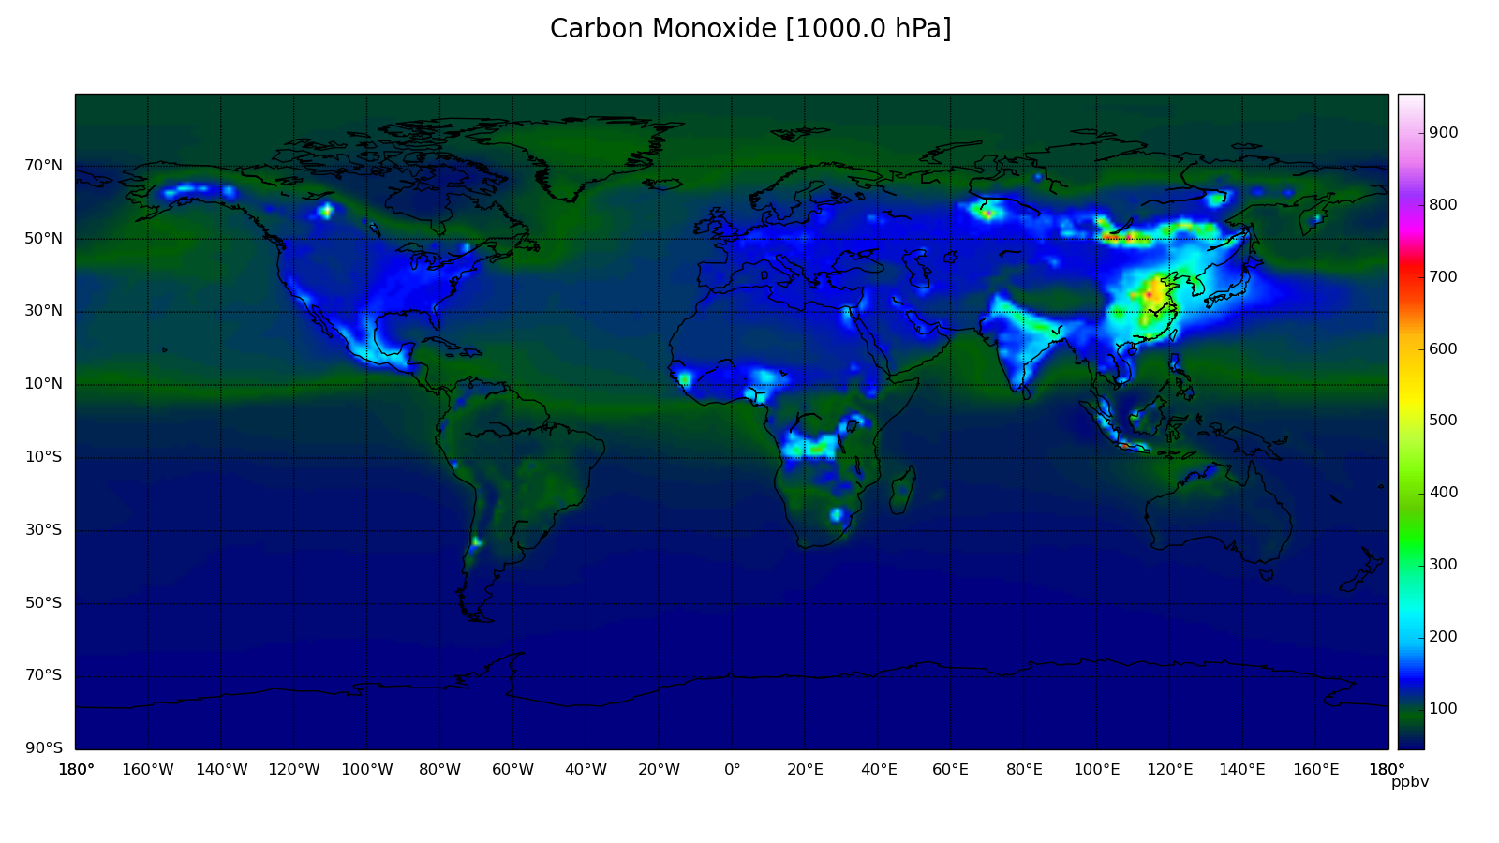

Slide 8
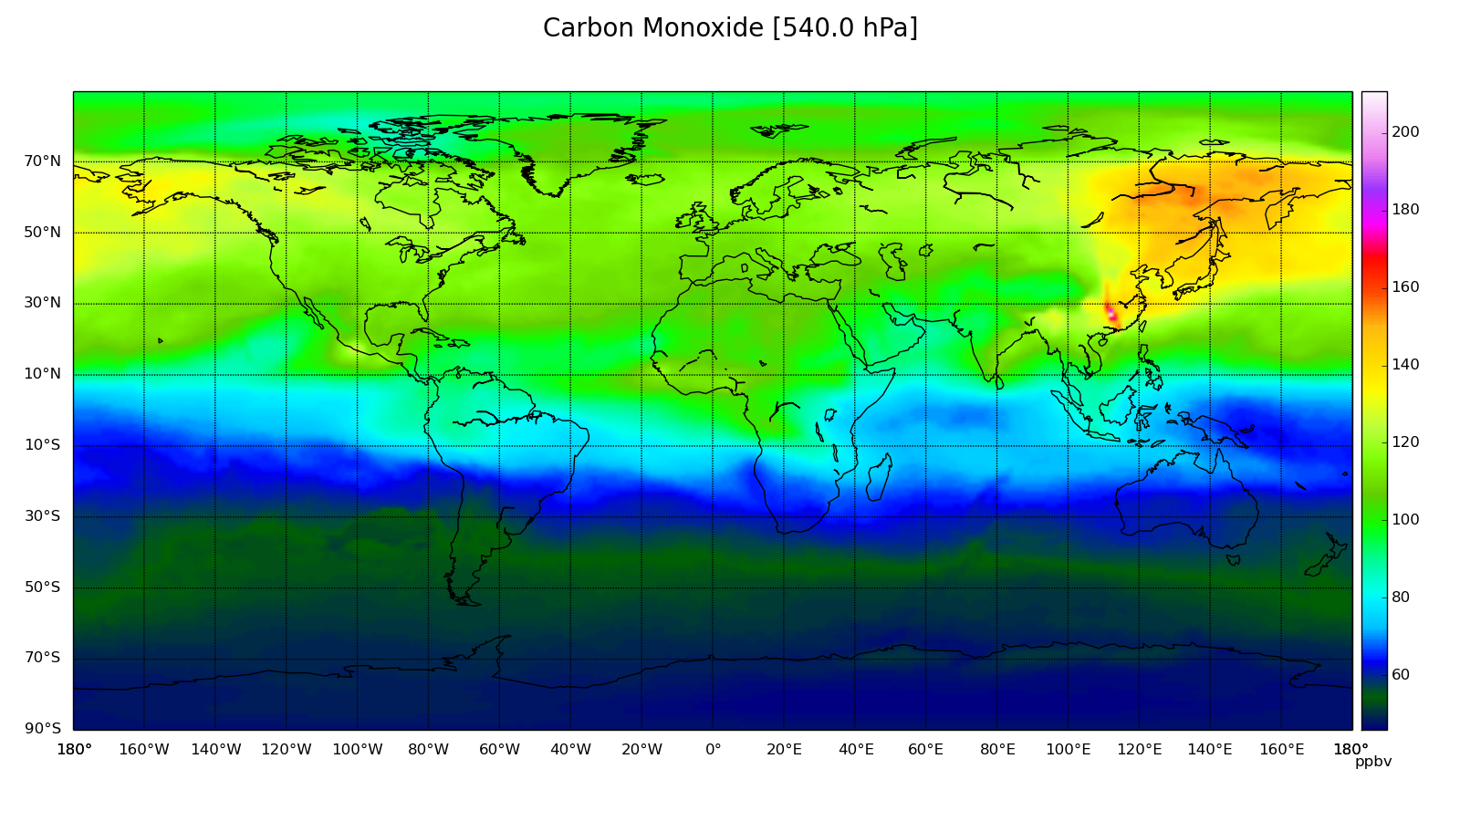

Slide 9
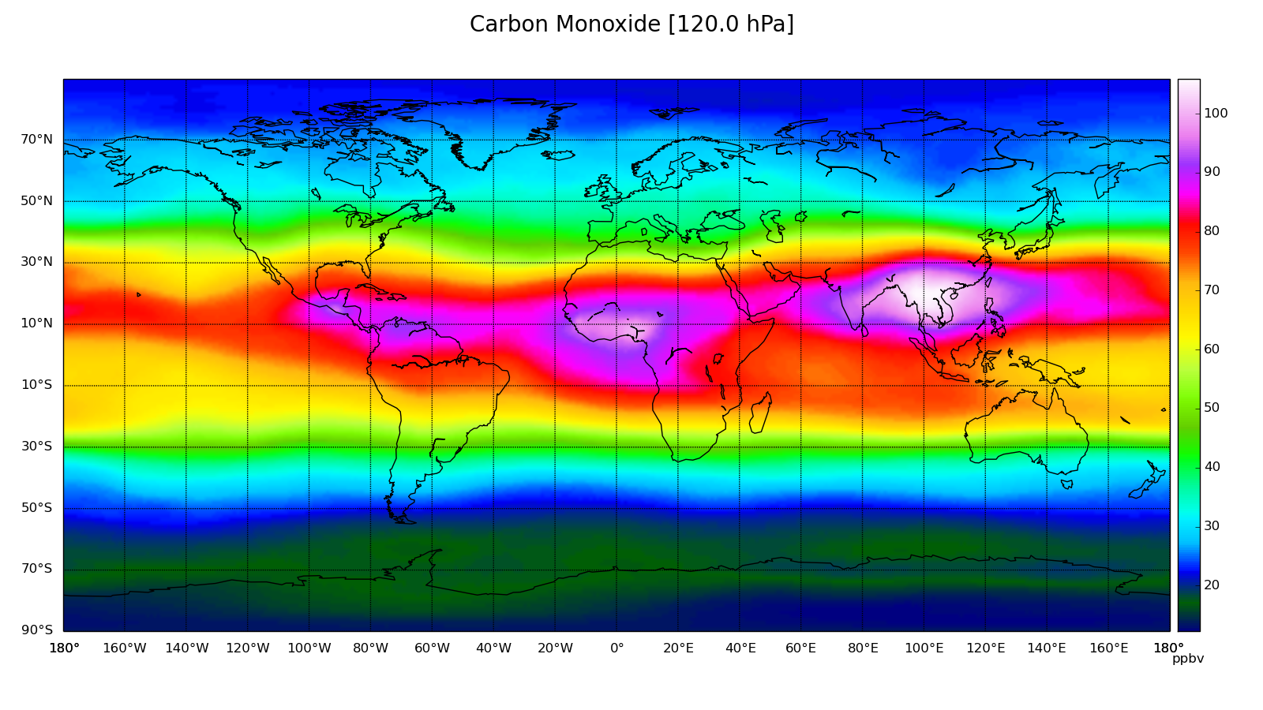

Slide 10
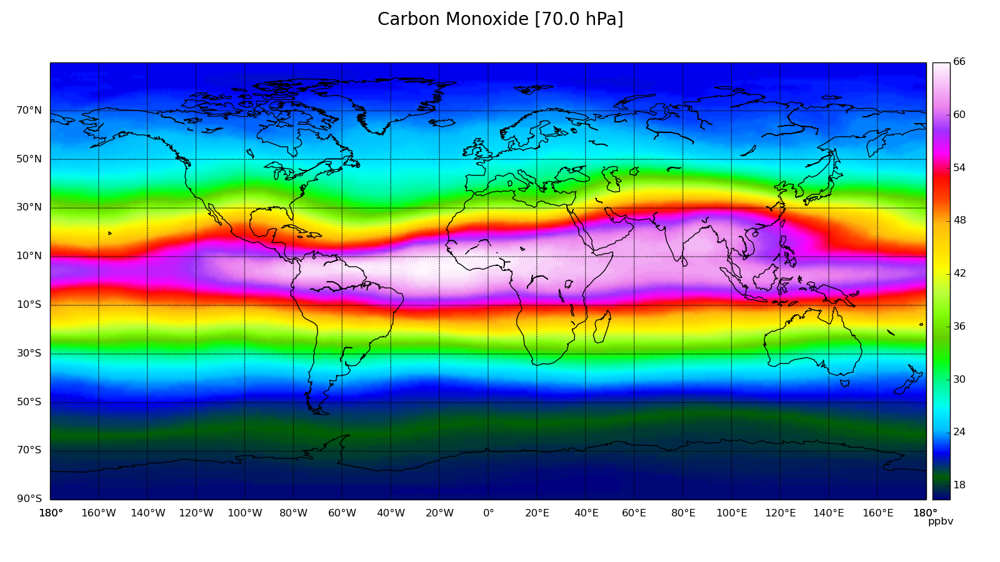

Slide 11
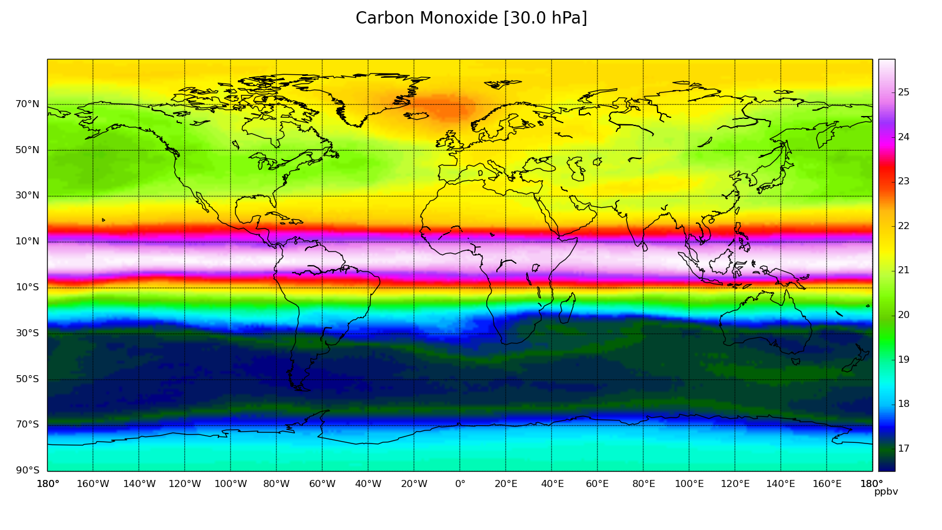

Slide 12
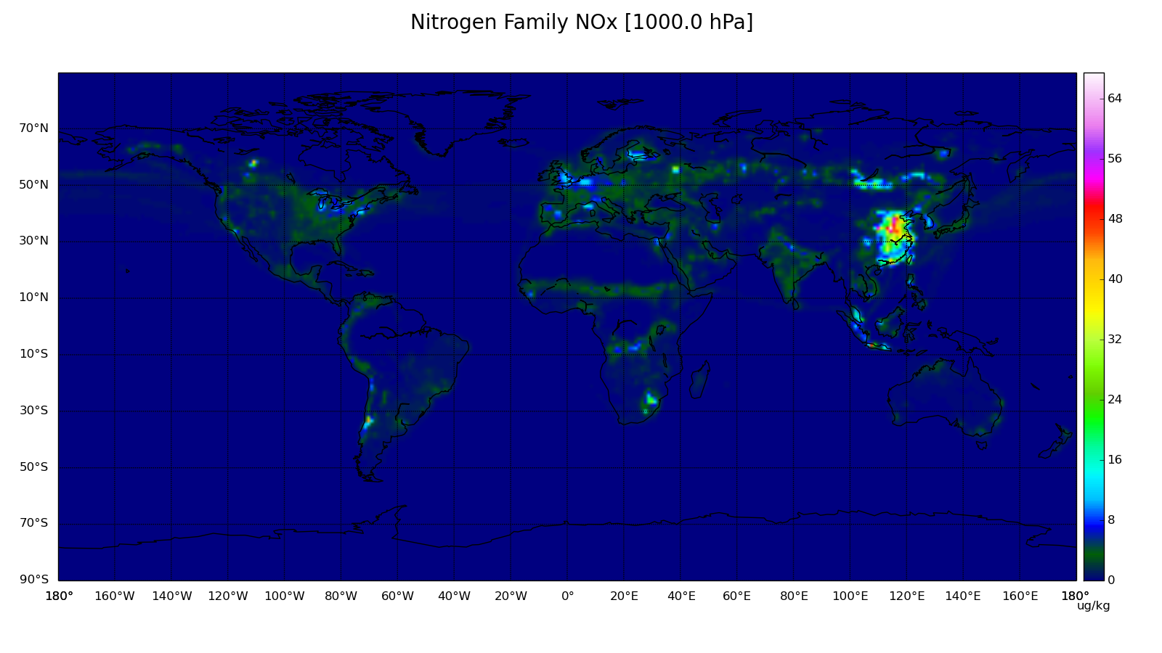

Slide 13
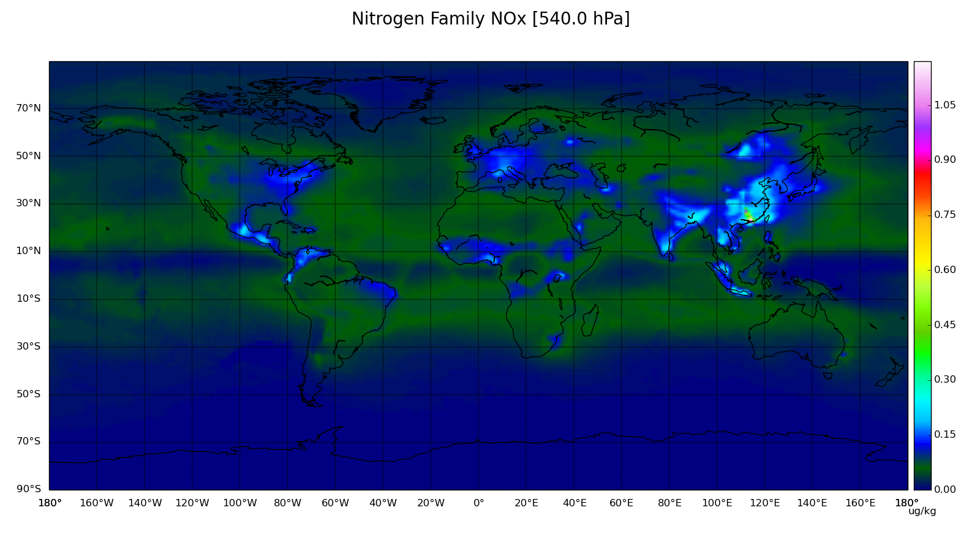

Slide 14
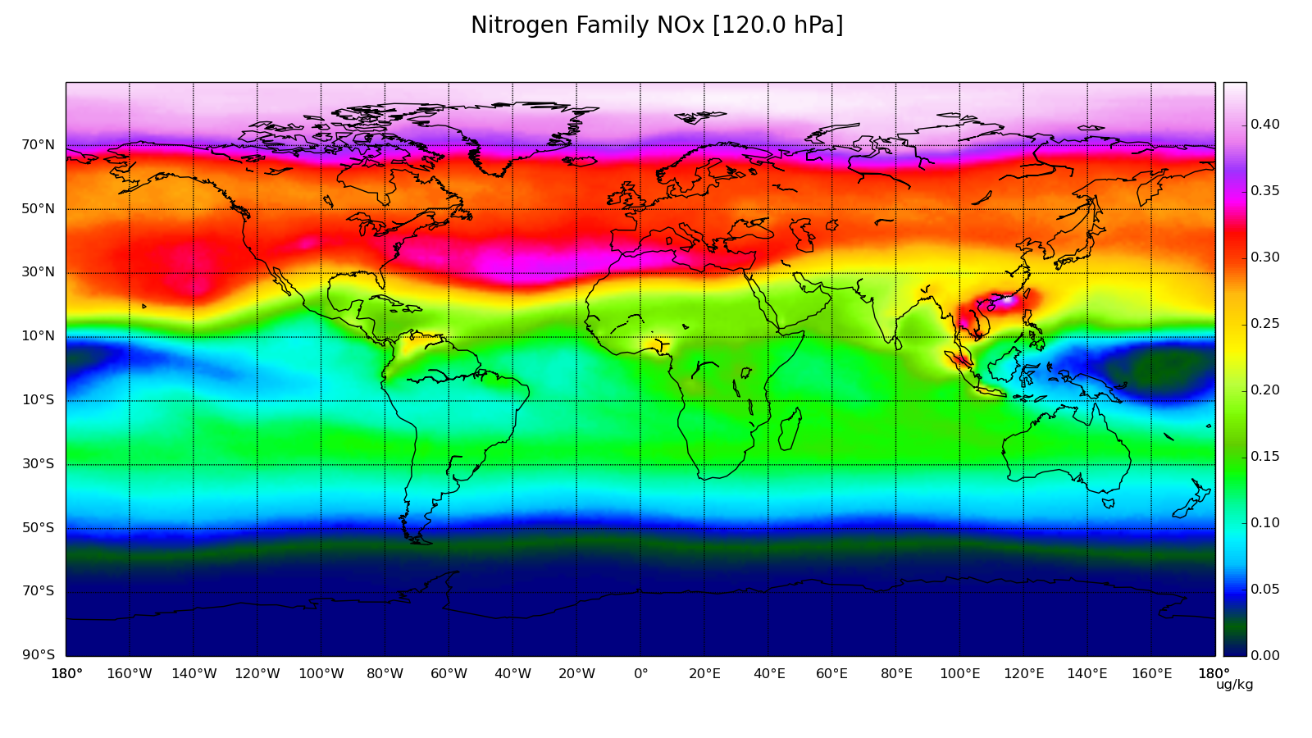

Slide 15
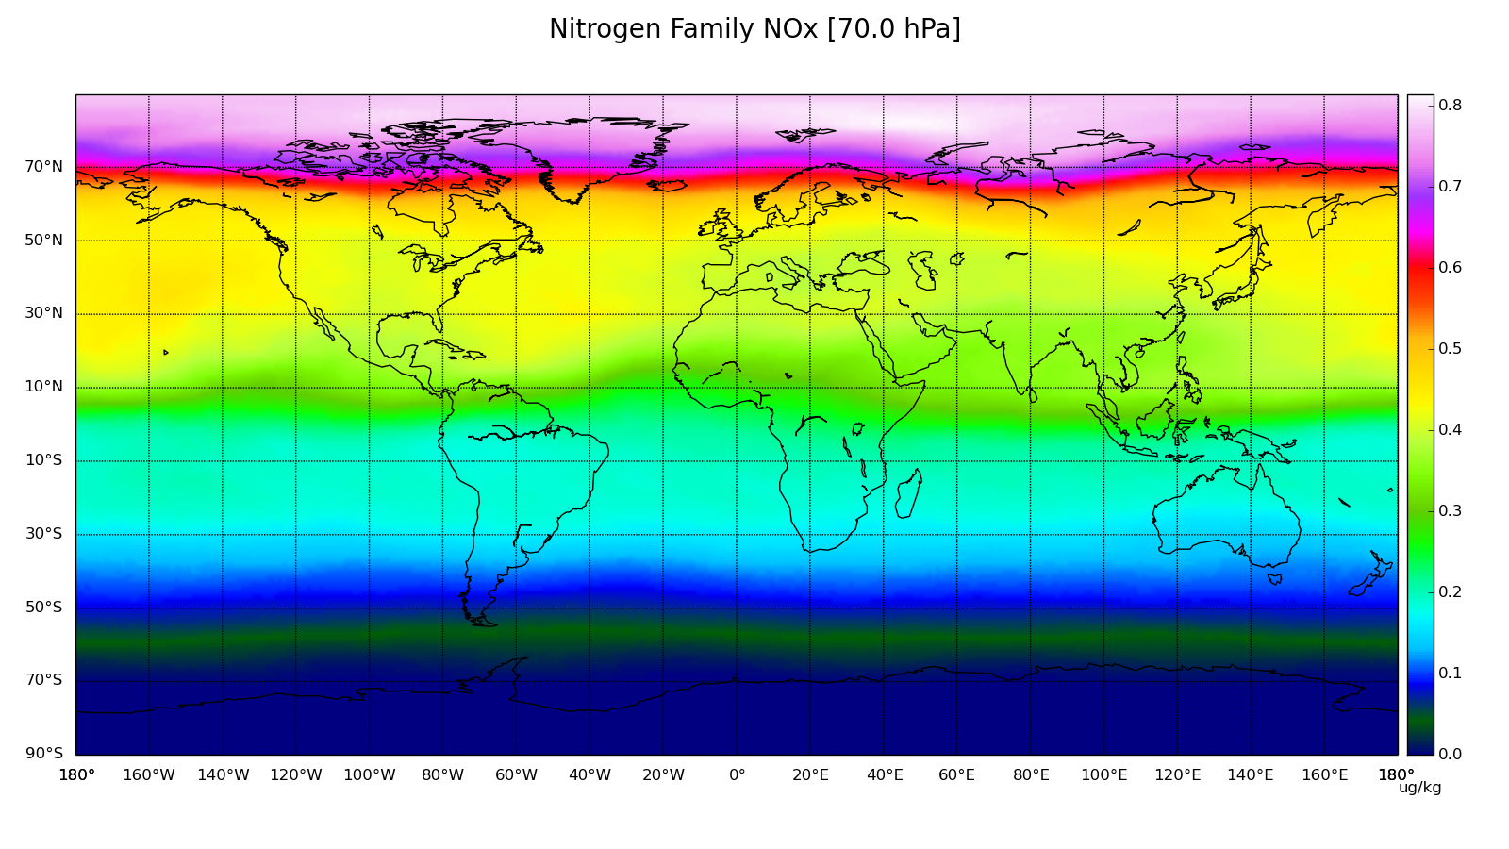

Slide 16
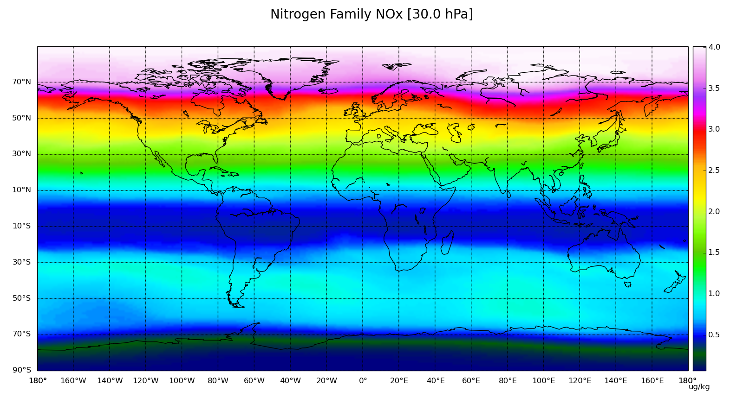

Slide 17
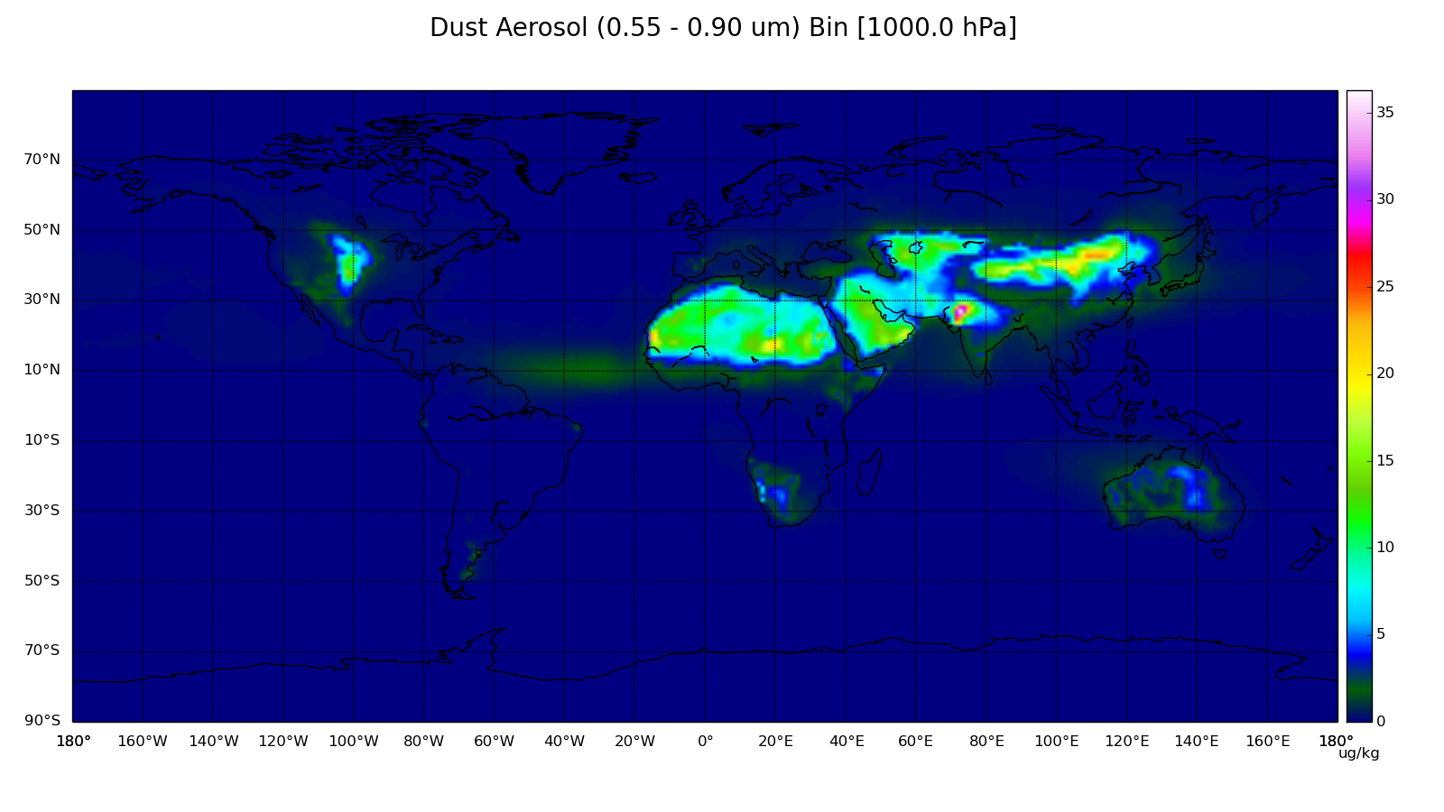

Slide 18
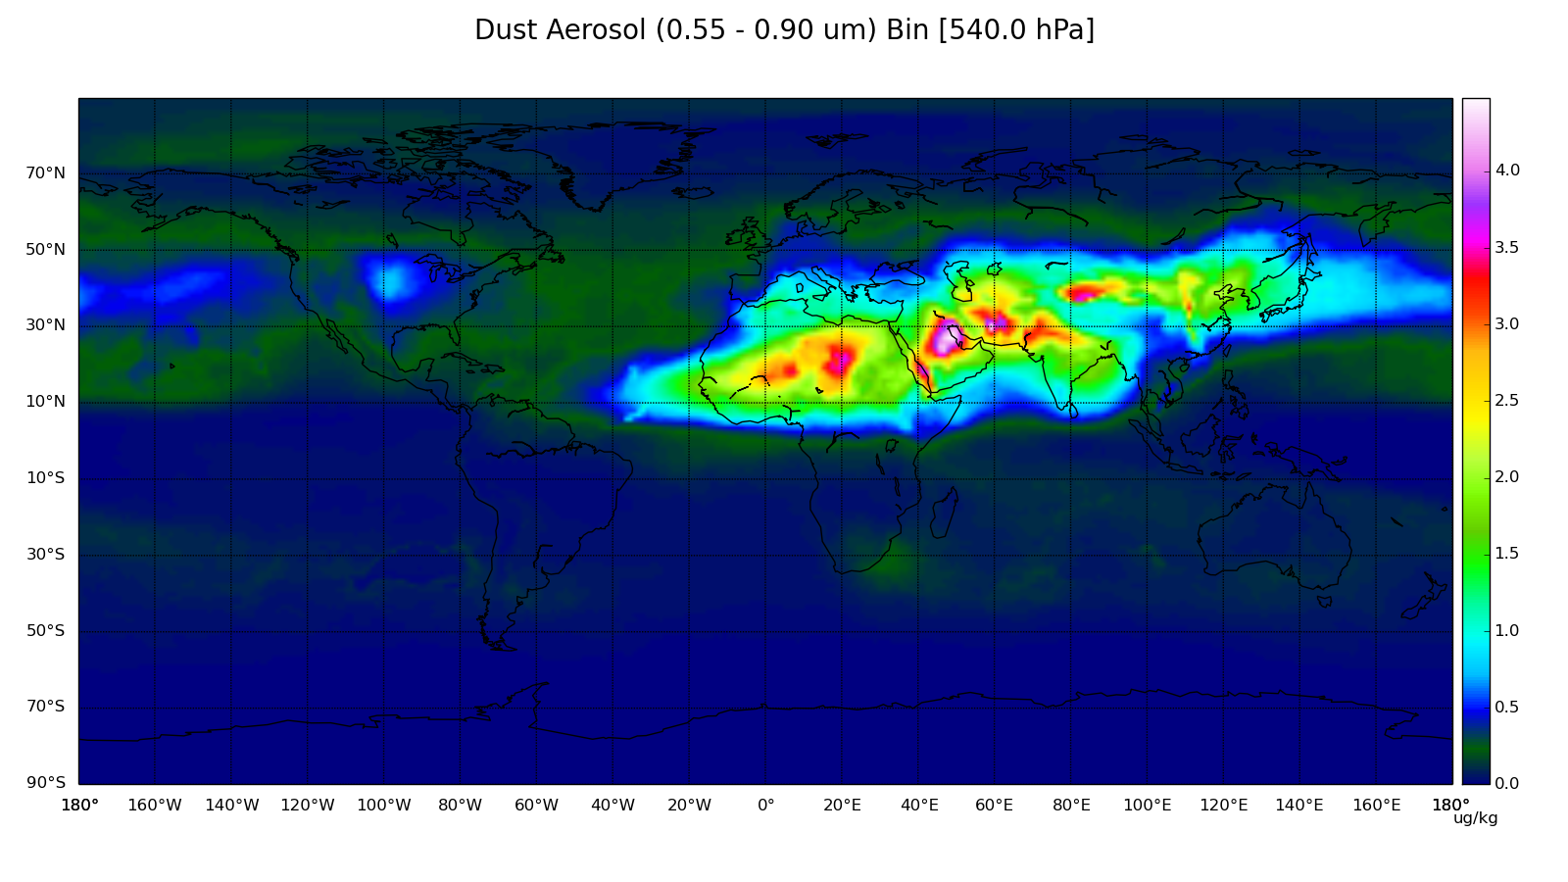

Slide 19
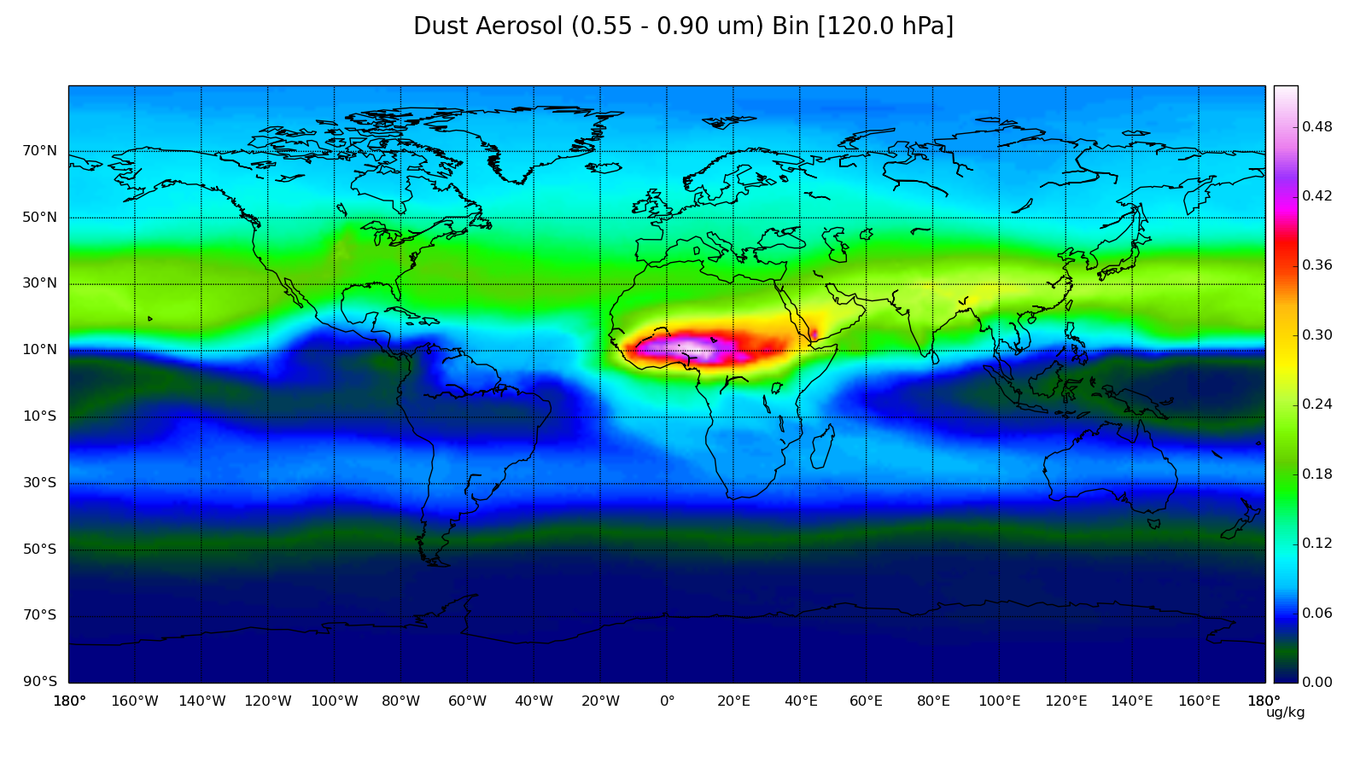

Slide 20
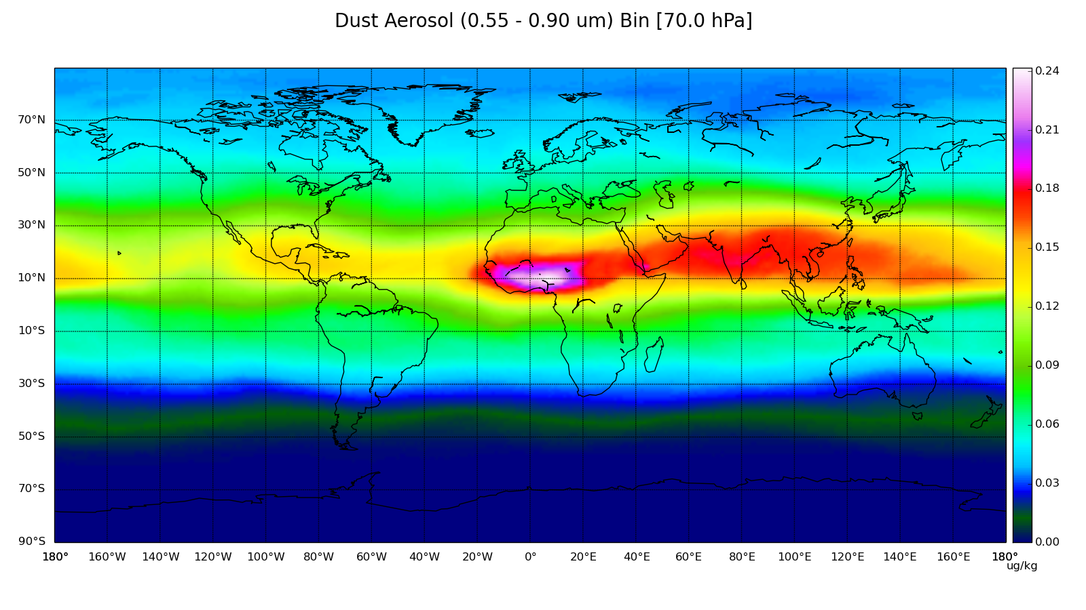

Slide 21
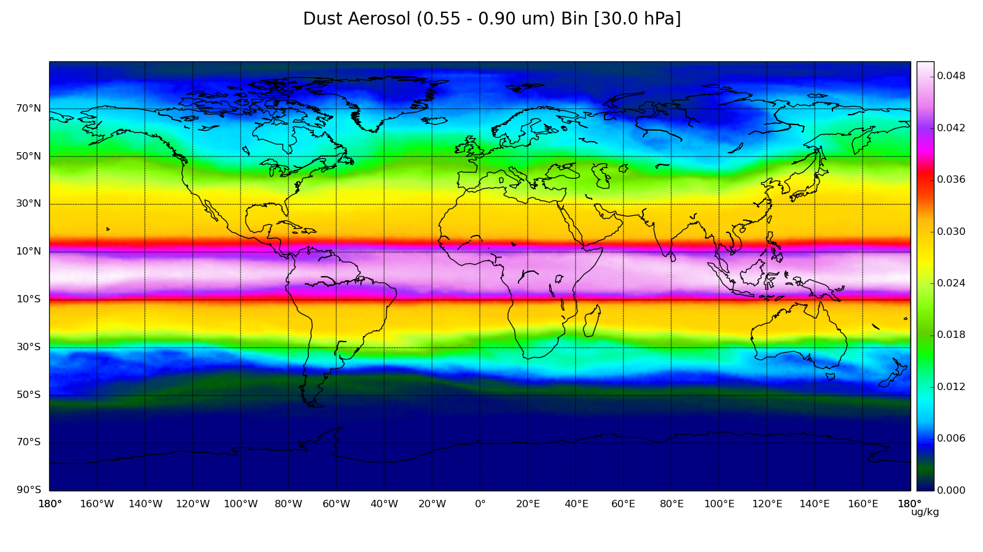

Slide 22
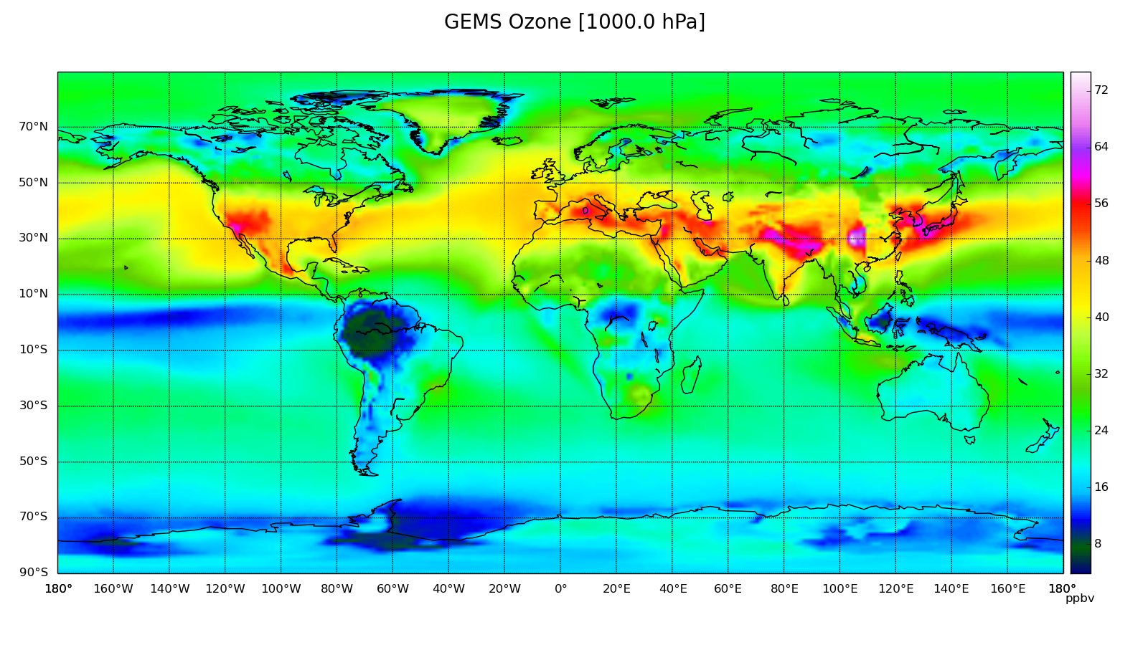

Slide 23
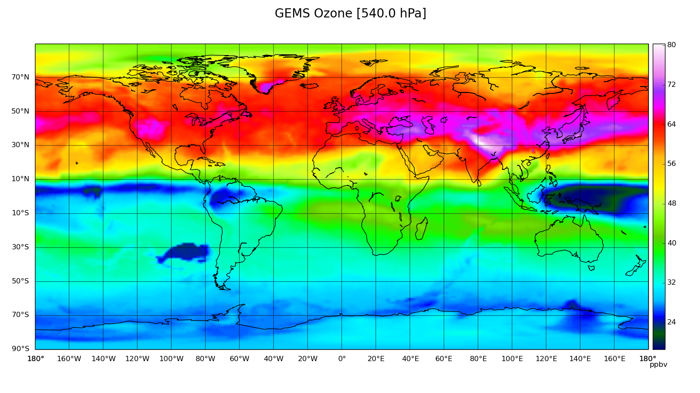

Slide 24
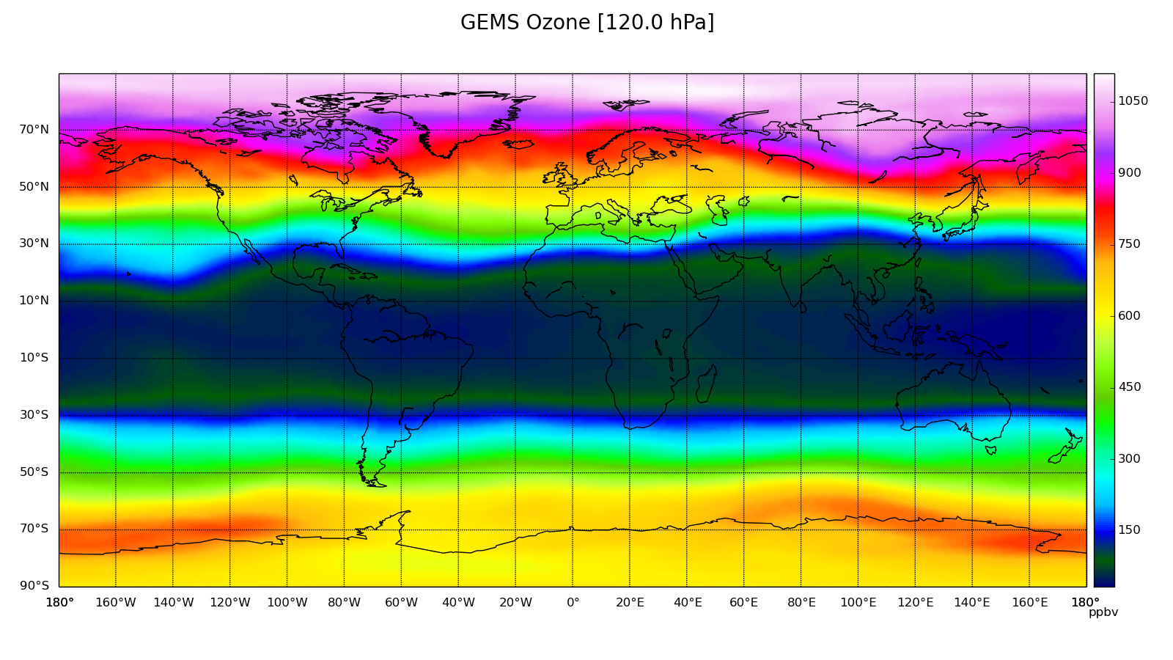

Slide 25
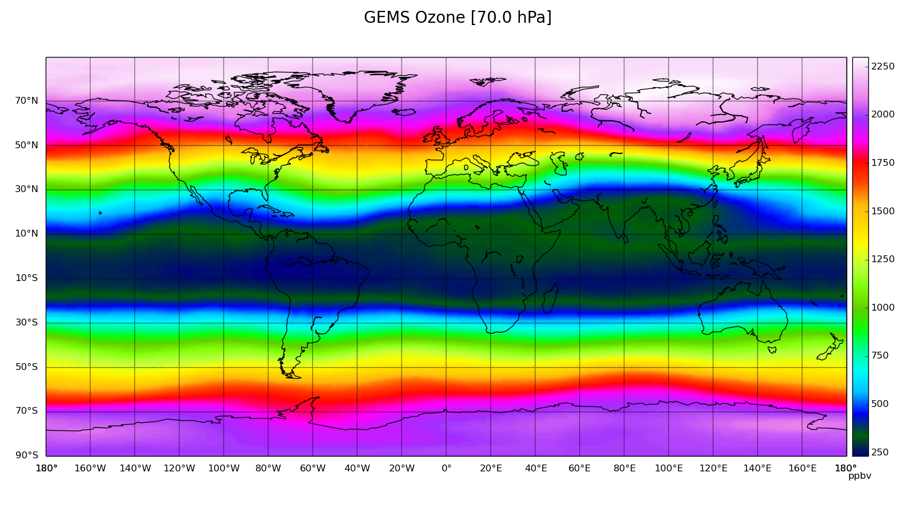

Slide 26
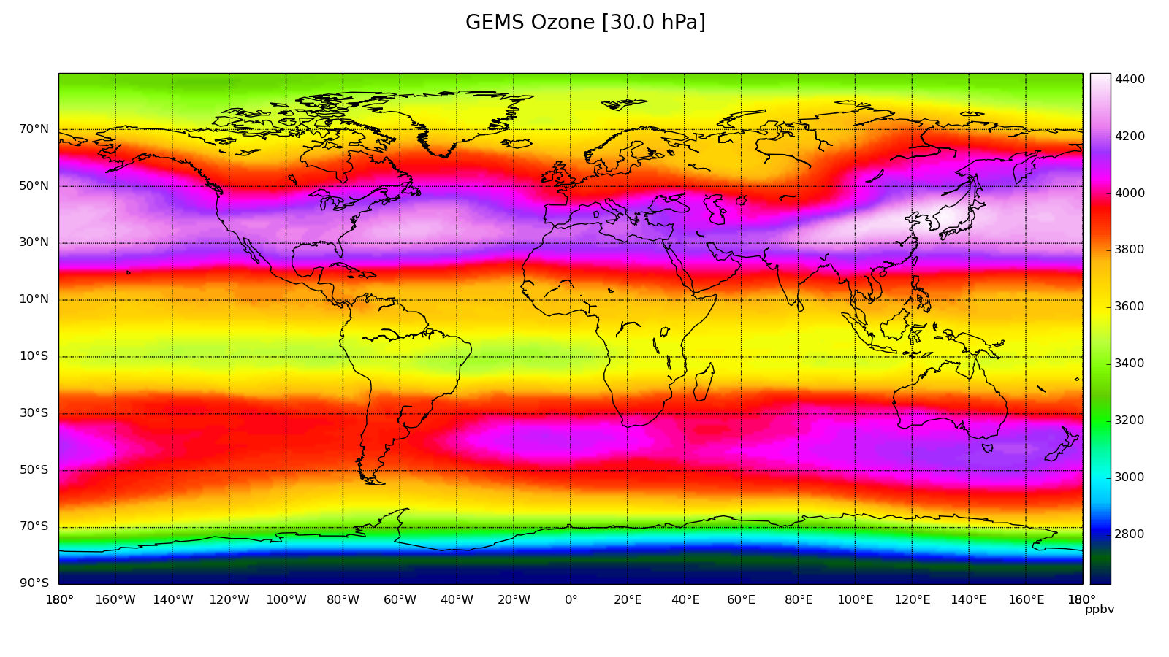

Slide 27
Here are a couple vertical cross sections taken from zonal means

Slide 28
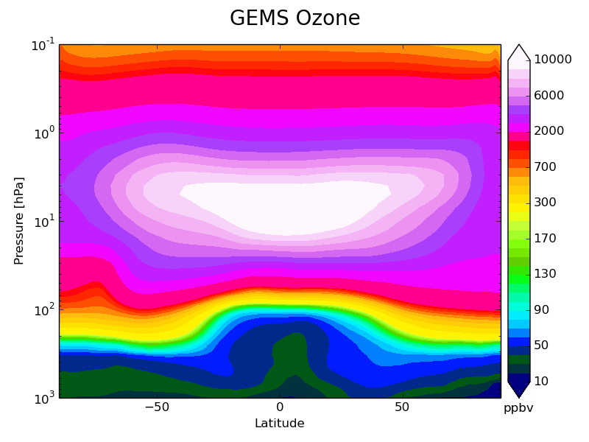
Sample – Vertical Cross Section for September – GEMS Ozone

Slide 29
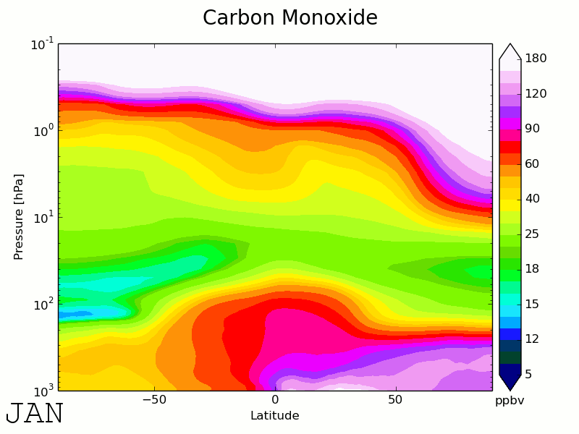
Samples – CO Animated Vertical Cross Section

Slide 30
Plot Directories
You can find the lat-lon grids for each month (starting from 0 as January, up to 11 as December) at
/home/ords/aq/alh002/latlon
Separated by month directories -> species name -> name_pressurelevel.png
Month directories seperated by integer (0 = January, 11 = December)
DST1 is smallest dust bin (0.03 - 0.55 μm), DST3 is biggest dust bin (0.90 - 20.0 μm), SAMR is Sulphate Aerosol Mixing Ratio (Sulphate Aerosol bin)
You can find the vertical cross sections for each month and species at
/home/ords/aq/alh002/vcross
Separated by species name -> name_monthint.png (0 as January, 11 as December)

Slide 31
Discrepancies
Very high altitudes often provide strange patterns or no data at all
Nonexistent data is generally predictably found in larger aerosols
“Proceed with caution” when analyzing high altitude lat-lon grids

Slide 32
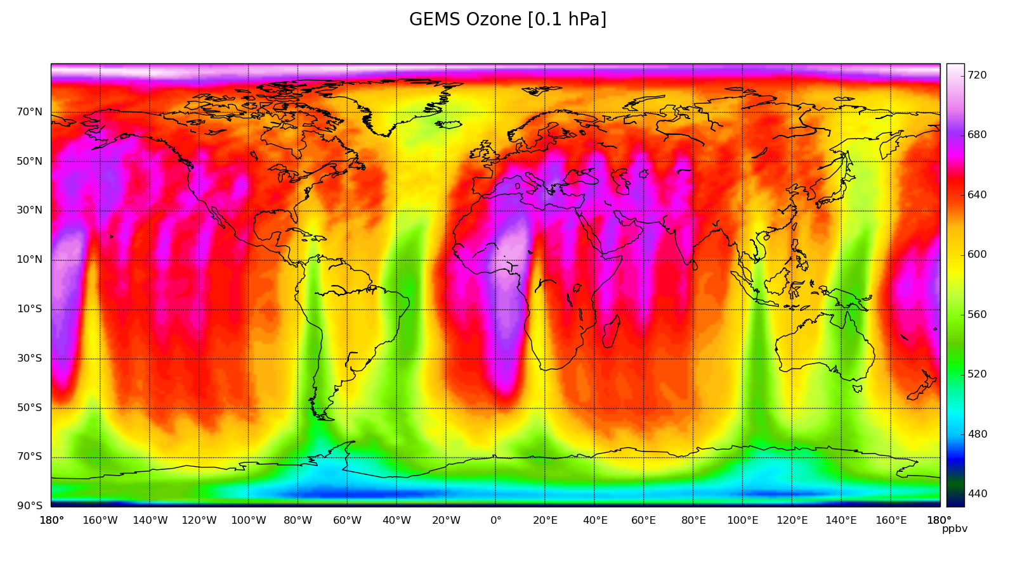
Sample – February GO₃ @ 0.1 hPa

Slide 33
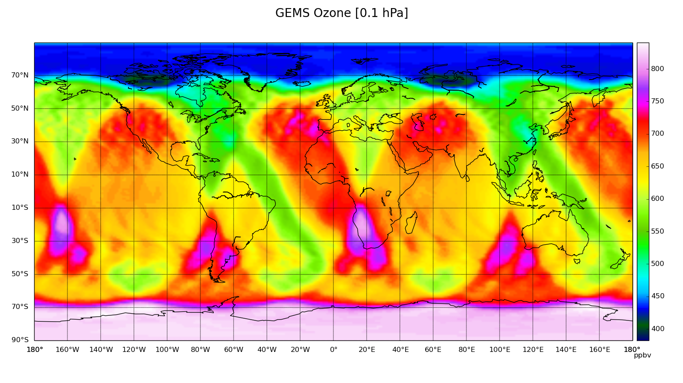
Sample – August GO₃ @ 0.1 hPa

Slide 34
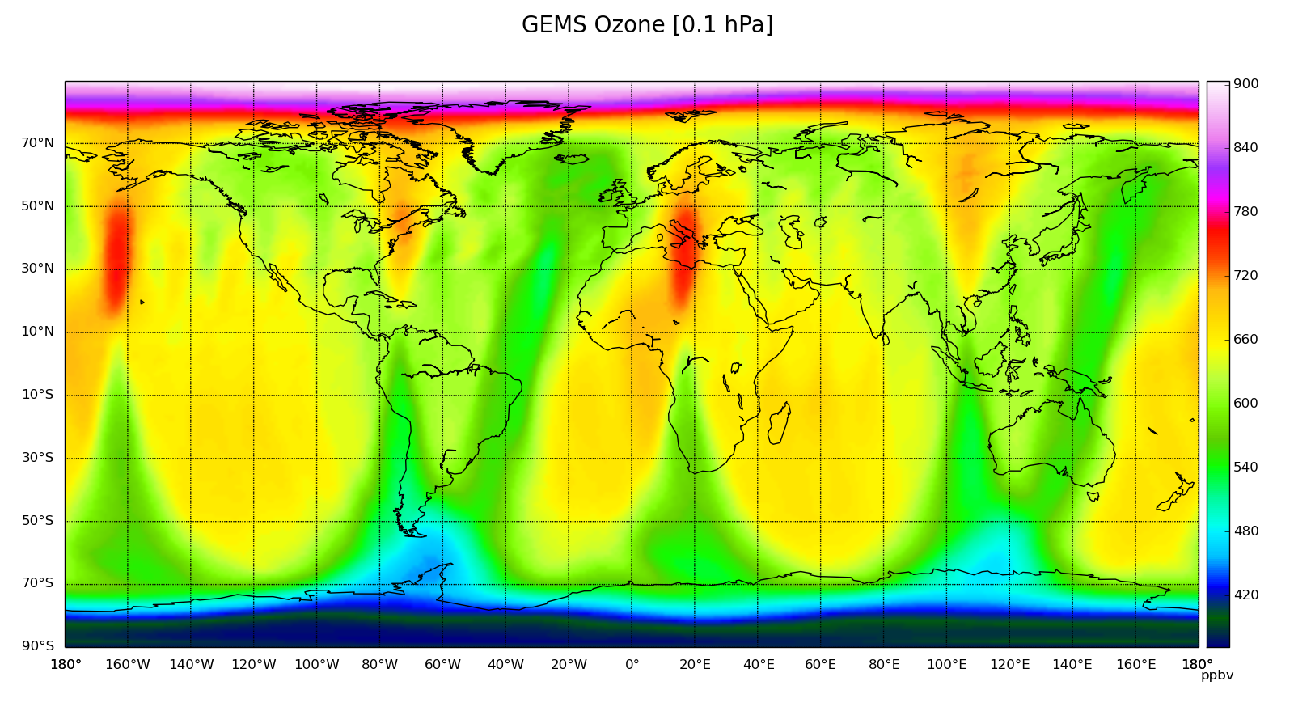
Sample – October GO₃ @ 0.1 hPa

Slide 35
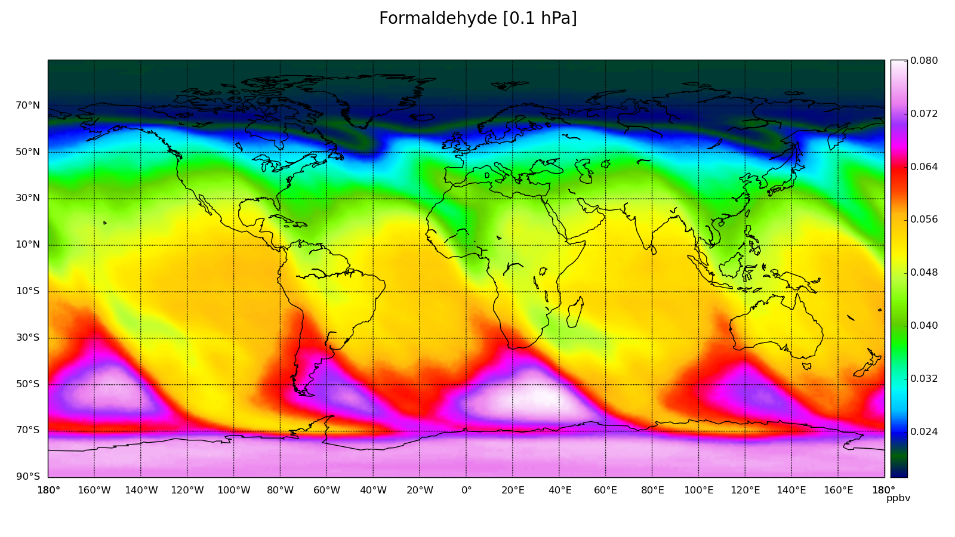
Sample – August HCHO @ 0.1 hPa

Slide 36
Discrepancies
Sulphur dioxide was only analyzed for the years of 2009 to 2012
Data exists from October 24th, 2008 to the end of 2008 but was not included, however it can be retrieved from NCDF directory
Directory: /space/hall1/sitestore/eccc/aq/r1/alh002/NCDF/SPECIES/SO2/INCOMPLETE

Slide 37
The Potential Use of MACC Reanalysis in Establishing Chemical Lateral Boundary Conditions
Diane Pendlebury
Ali Hasan

Slide 38
Background Information
Previously, using chemical lateral boundary conditions (CLBC) from MACC Reanalysis (updated every 6 hours) has been shown to improve surface ozone prediction during stratospheric intrusion events
The DynOzone method using ozonesonde data can provide CLBC’s for the regional GEM-MACH model
Using the CLBC’s defined by the ozonesonde dataset worked to better define the ozone field in the tropopause region, but tropospheric ozone was generally too high
Proposed was to utilize the DynOzone method with MACC Reanalysis data taking the place of ozonesonde data
The following second half of the presentation will display some results using the DynOzone + MACC Reanalysis derived CLBC’s, along with comparisons to DynOzone + Ozonesonde, MOZART4 (seasonal averaged), and MACC Reanalysis derived CLBC’s

Slide 39
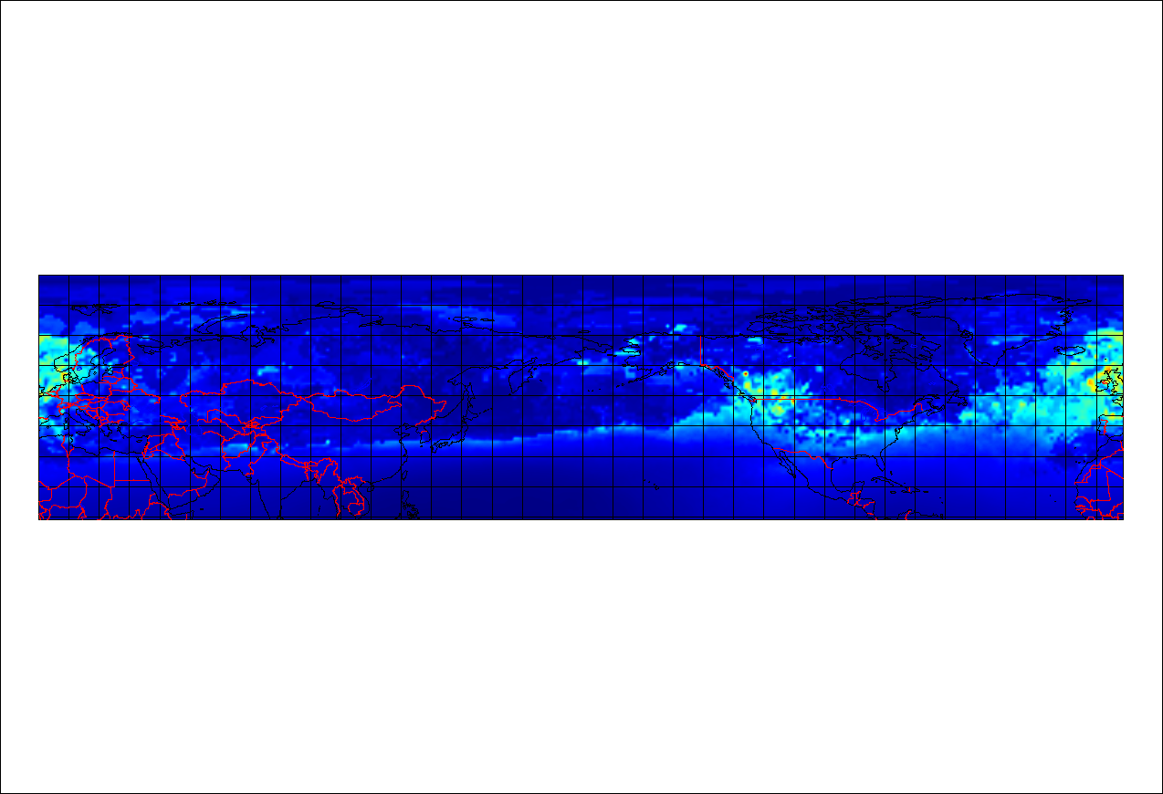
Averaged (2008 -2012) Tropospheric Ozone @ 100mb through January

Slide 40
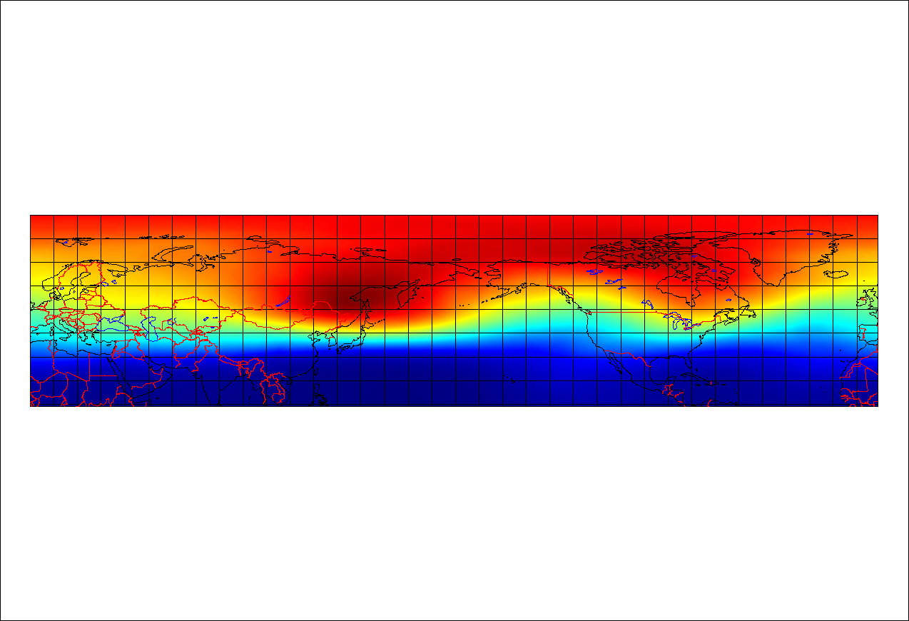
Averaged (2008 -2012) Stratospheric Ozone @ 100mb through January

Slide 41
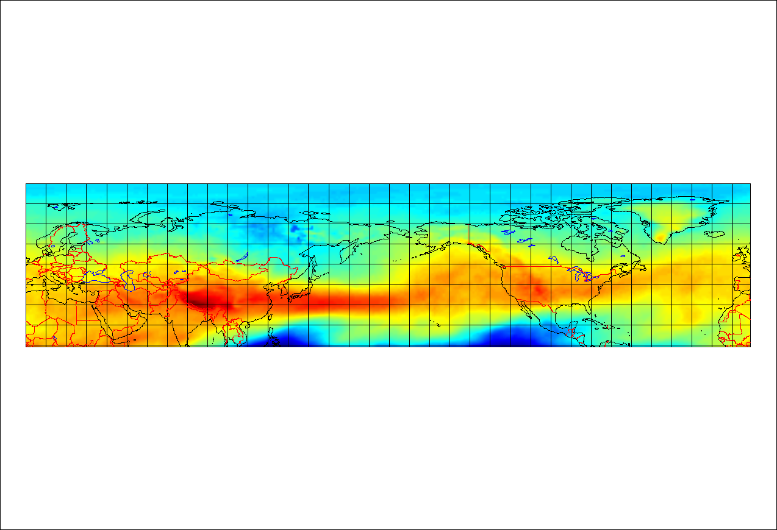
Averaged (2008 -2012) Tropospheric Ozone @ 500mb through January

Slide 42
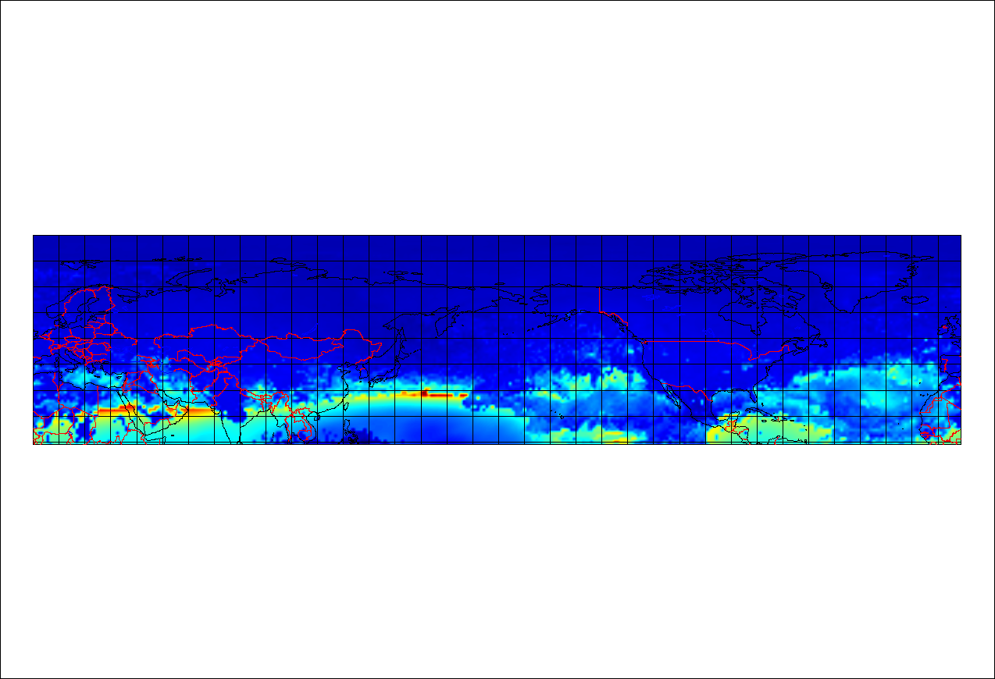
Averaged (2008 -2012) Stratospheric Ozone @ 500mb through January

Slide 43
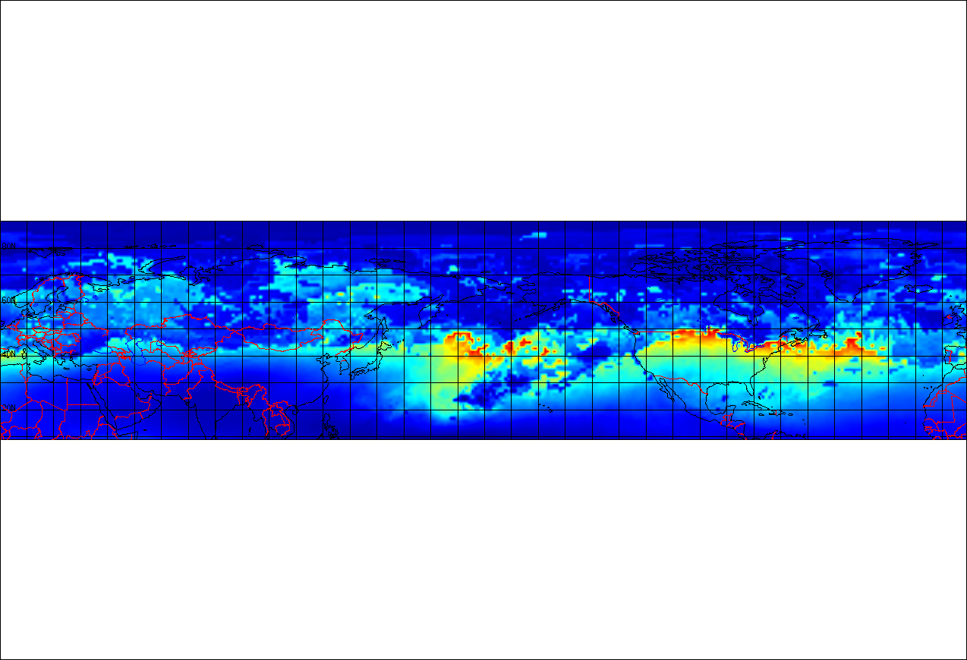
Averaged (2008 -2012) Tropospheric Ozone @ 100mb through July

Slide 44
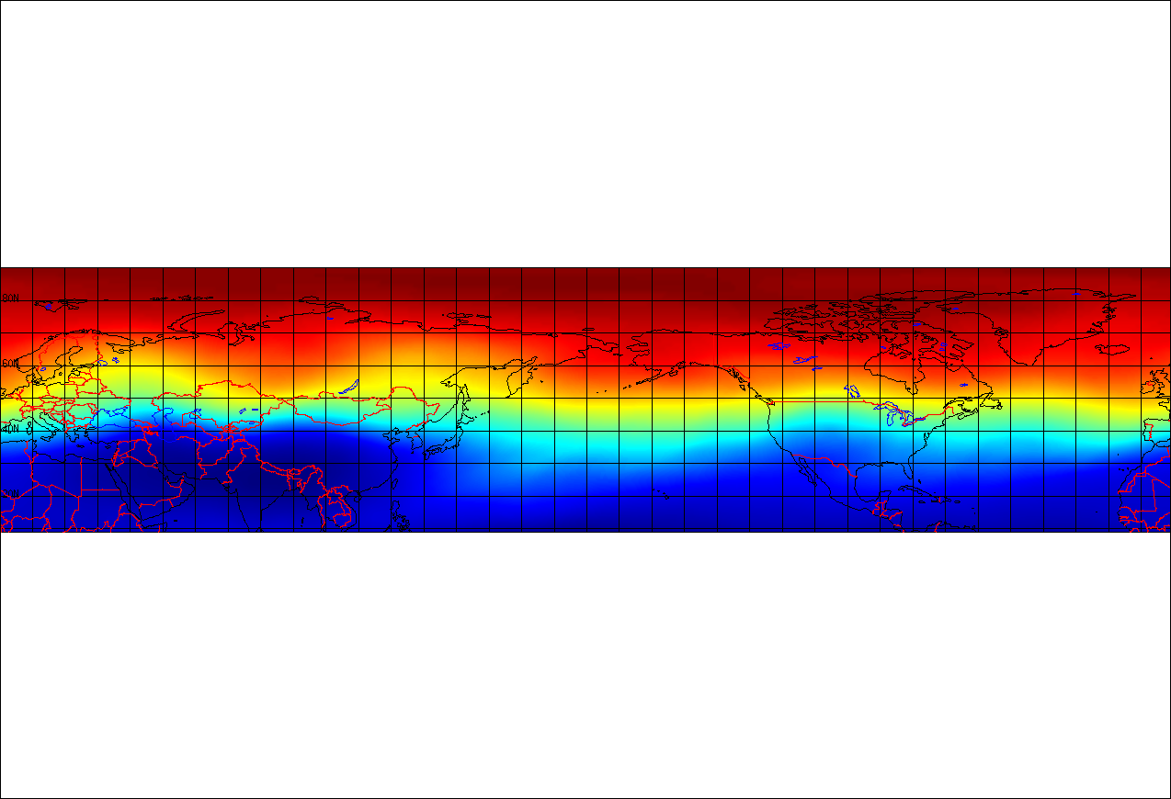
Averaged (2008 -2012) Stratospheric Ozone @ 100mb through July

Slide 45
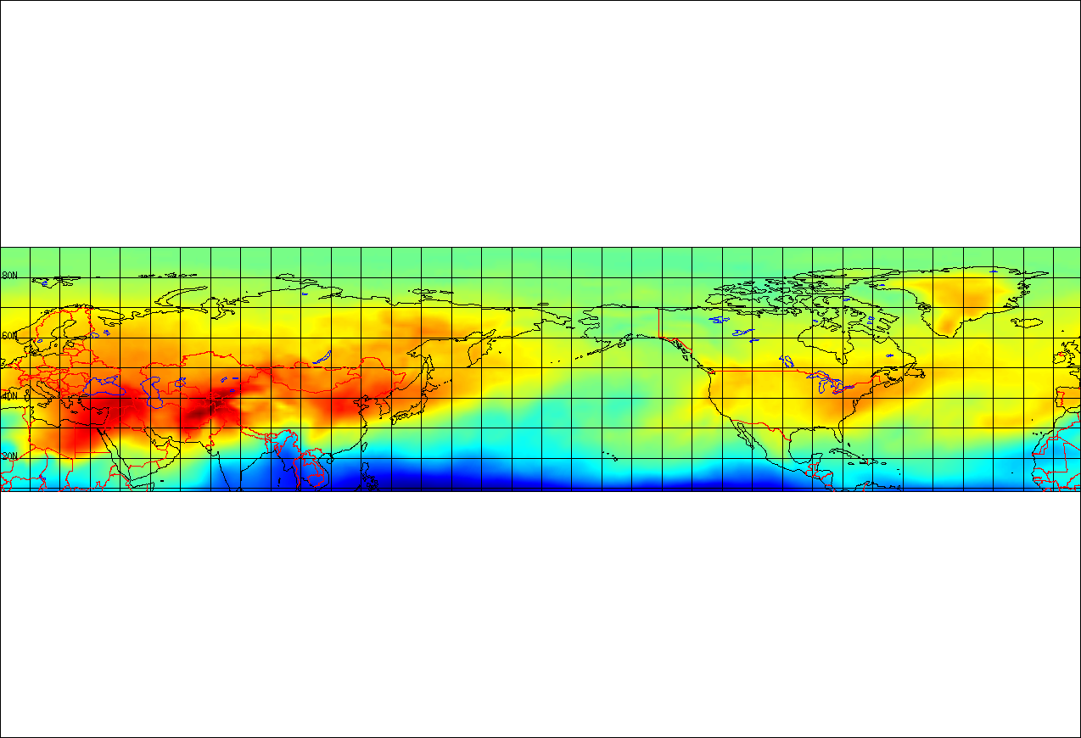
Averaged (2008 -2012) Tropospheric Ozone @ 500mb through July

Slide 46
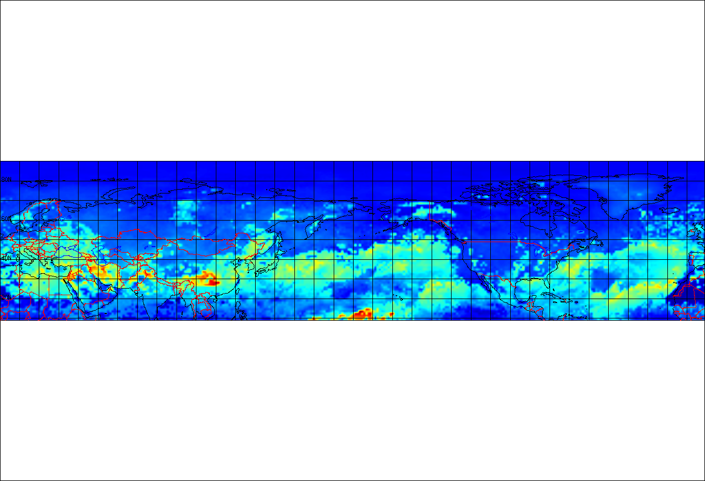
Averaged (2008 -2012) Stratospheric Ozone @ 500mb through July

Slide 47
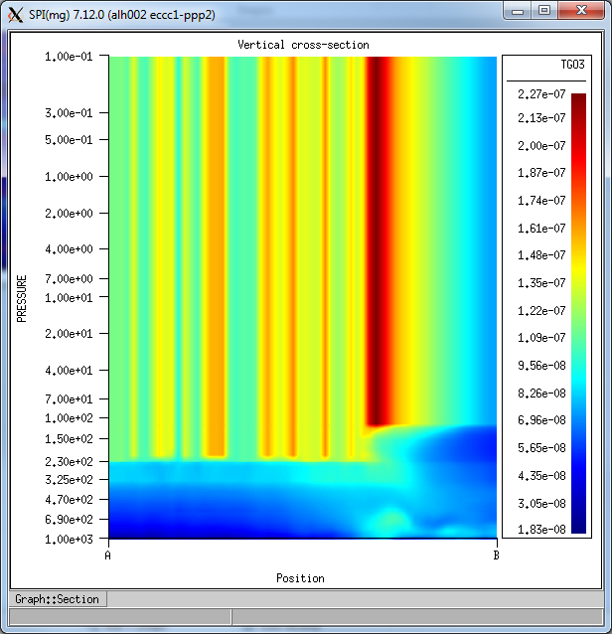
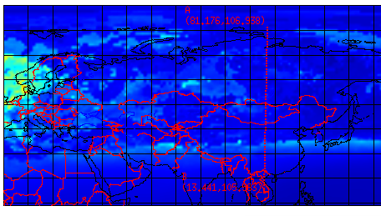
Vertical Cross Section of January for Tropospheric Ozone
These figures were made in SPI
The top figure is the vertical cross section
The bottom figure is the area of the cross section
The units, although not specified properly, are kg/kg (as per the ECMWF parameters database)
The reasoning behind the vertical cross section appearing “glitched” is by design - due to filling zeros with nearest non zero value (nearest in tropospheric being the highest level nonzero value)

Slide 48
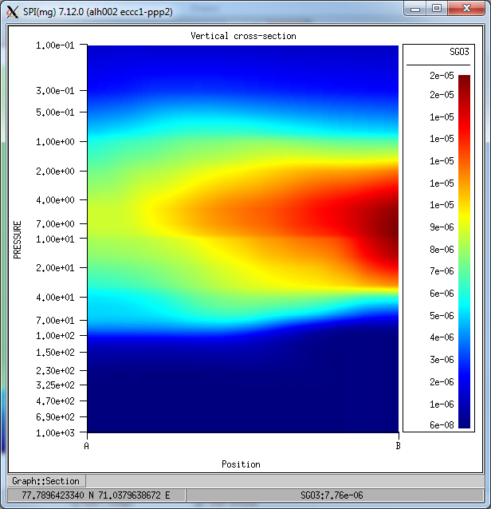
Vertical Cross January for Stratospheric Ozone of January
These figures were made in SPI
The top figure is the vertical cross section
The bottom figure is the area of the cross section
The units, although not specified properly, are kg/kg (as per the ECMWF parameters database)
The reasoning behind the vertical cross section appearing “glitched” is by design - due to filling zeros with nearest non zero value (nearest in stratospheric being the lowest level nonzero value)

Slide 49
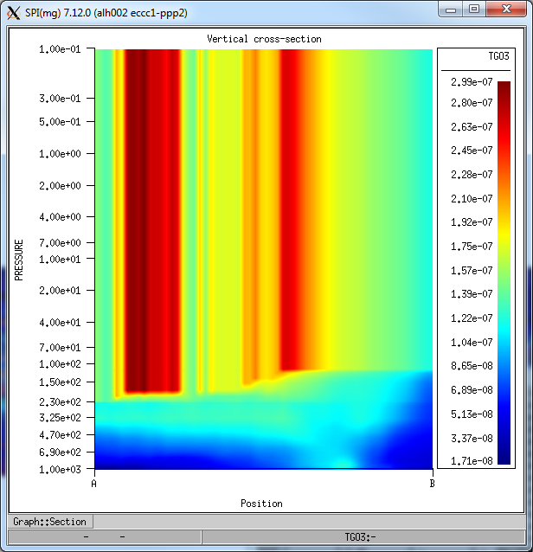
Vertical Cross Section of Tropospheric Ozone for July
These figures were made in SPI
The top figure is the vertical cross section
The bottom figure is the area of the cross section
The units, although not specified properly, are kg/kg (as per the ECMWF parameters database)
The reasoning behind the vertical cross section appearing “glitched” is by design - due to filling zeros with nearest non zero value (nearest in tropospheric being the highest level nonzero value)

Slide 50
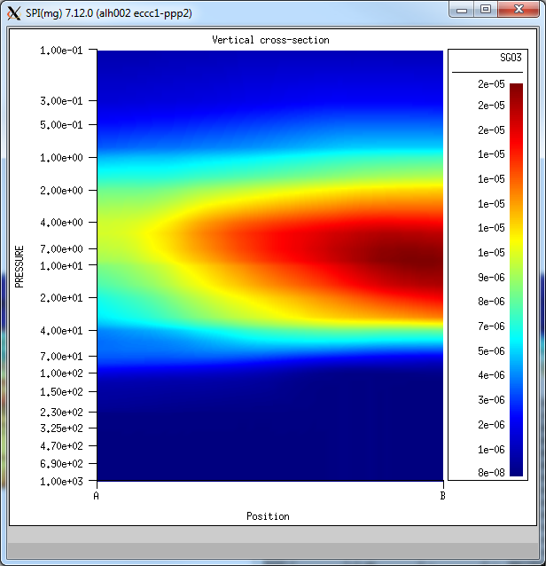
Vertical Cross for Stratospheric Ozone of July
These figures were made in SPI
The top figure is the vertical cross section
The bottom figure is the area of the cross section
The units, although not specified properly, are kg/kg (as per the ECMWF parameters database)
The reasoning behind the vertical cross section appearing “glitched” is by design - due to filling zeros with nearest non zero value (nearest in stratospheric being the lowest level nonzero value)

Slide 51
Preliminary Results
Preliminary results were run on Hadar
The intention of reducing tropospheric ozone in the DynOzone method + MACC Reanalysis dataset looks partially successful
However, the impact of stratospheric intrusion isn’t as prevalent in surface and lower stratospheric ozone levels

Slide 52
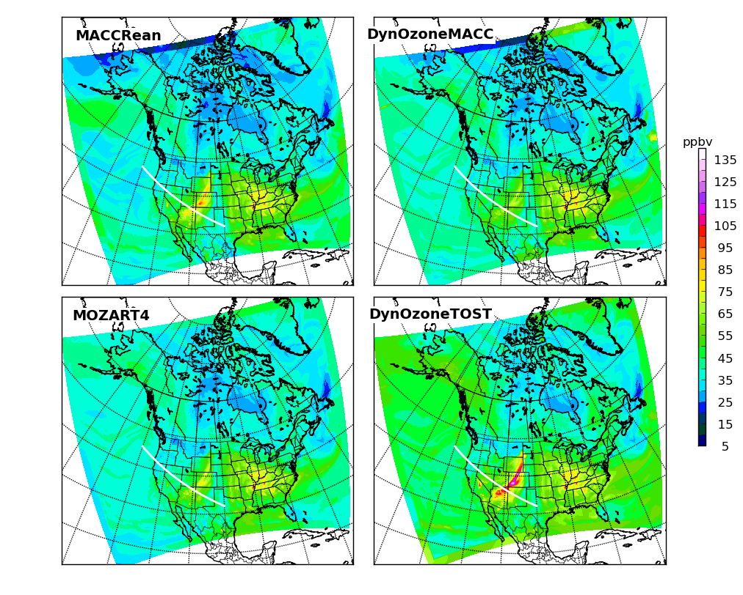
Comparison of the four CLBC strategies modelling the surface level ozone for the regional GEM-MACH at April 13, 2010 21:00:00 GMT. An intrusion can be noted over western United States. The white intersecting contour is the location of the vertical cross sections produced.

Slide 53
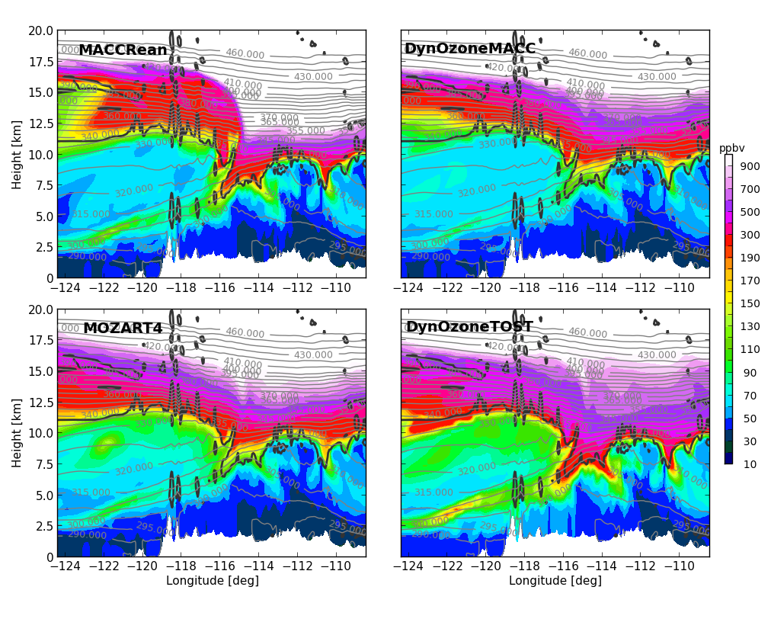
Comparison of the four CLBC strategies modelling the vertical cross section intersecting the stratospheric intrusion in the western United States at April 13, 2010 21:00:00 GMT. An intrusion can be noted over around -117 to -113 degrees on the longitude axis by the sudden increase in tropospheric ozone. The black contour line is a 2.0 PVU contour, and the grey lines are potential temperature

Slide 54
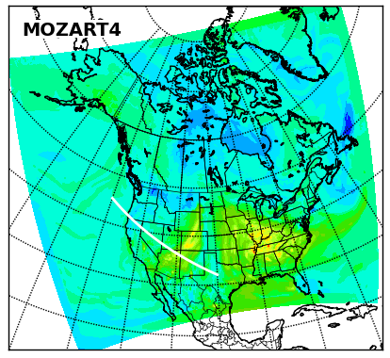
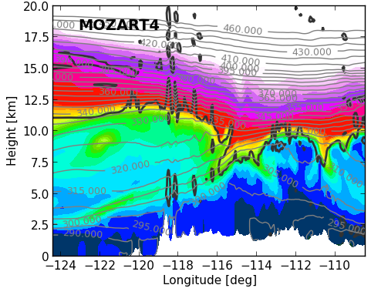
Stratospheric intrusion analysis/MOZART4
On the surface level, MOZART4 CLBC’s did fairly well in comparison to the three other methods regarding representation of the stratospheric intrusion
It portrays more surface level ozone than the DynOzone + MACC Reanalysis method, and less than both the MACC Reanalysis and DynOzone + Ozonesonde methods

Slide 55
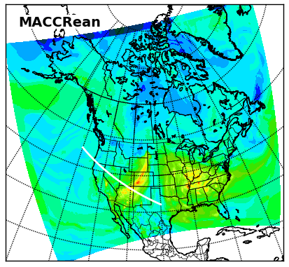
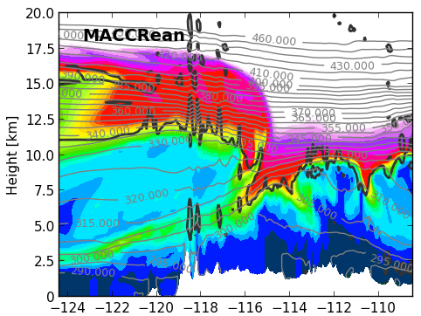
Stratospheric intrusion/MACC Reanalysis
On the surface level, MACC Reanalysis CLBC’s overly expressed the surface ozone concentrations. This is especially present in the stratospheric intrusion over western United States
It portrays more surface level ozone than the MOZART4 and DynOzone + MACC Reanalysis methods, and less than the DynOzone + Ozonesonde method
Note the high ozone concentrations below the tropopause – the goal is to decrease these with the DynOzone + MACC Reanalysis strategy

Slide 56
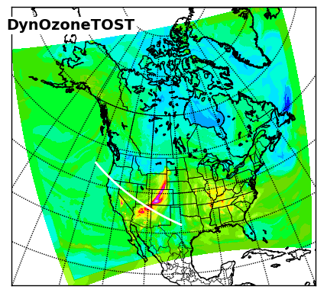
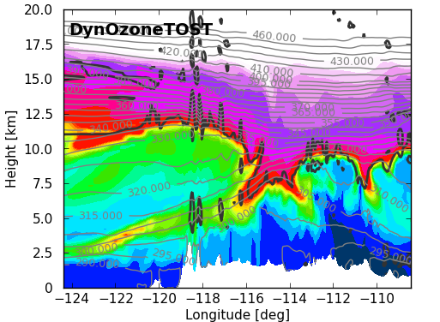
Stratospheric intrusion analysis/DynOzone + Ozonesonde
On the surface level, the DynOzone + Ozonesonde method distinguishes itself from the other three methods by expressing the most ozone at the surface level
The expression of ozone is not only present in the stratospheric intrusion, but also across the entirety of the surface
Looking at the vertical cross section, this expression is present yet again. The red contour level are almost all beyond the 2.0 PVU contour
By design however, it does create a strong shape around the 2.0 PVU contour

Slide 57
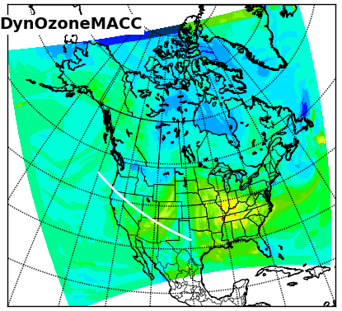
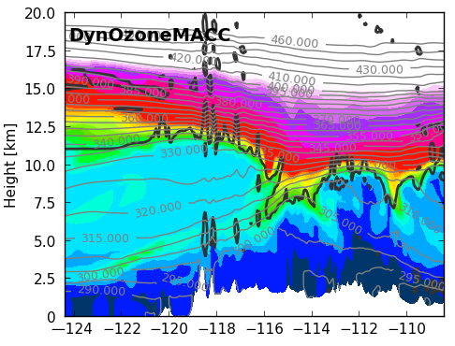
Stratospheric intrusion analysis/DynOzone + MACC Reanalysis
On the surface level, the DynOzone + MACC Reanalysis method is not representing the stratospheric intrusion as strongly
This is also represented in the vertical cross section, where the high contour values do not as strong a shape around the stratospheric intrusion as a result of this low expression of ozone in the area of the intrusion
However, the area below the tropopause is represented with lower concentrations than the MACC Reanalysis, which was intended
In this case, the DynOzone + MACC Reanalysis performed no better than the MOZART4 seasonal average CLBC’s
It is, however, overall much lower than the DynOzone + Ozonesonde, which was intended

Slide 58
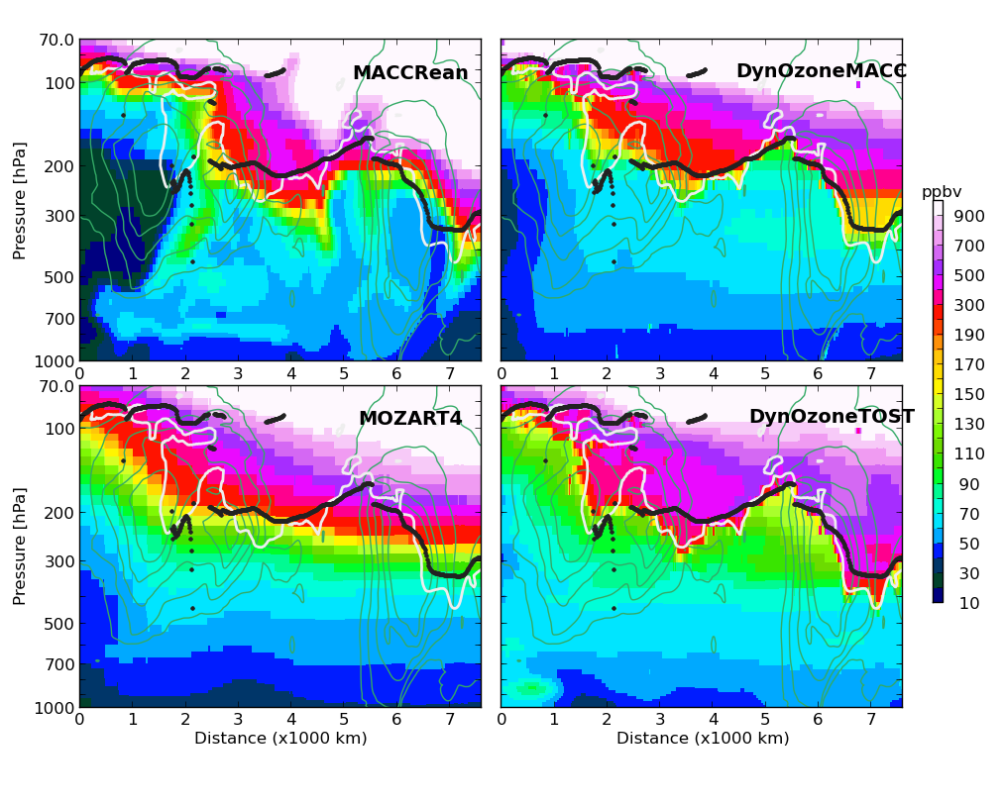
Comparison of the four CLBC models over the western lateral boundary for GEM-MACH at April 13, 2010 21:00:00 GMT. The black contour is the thermal tropopause, the white contour is a dynamic tropopause based off a potential vorticity contour of 2.0 PVU (from GEM-MACH (piloting meteorology). The teal contours are the kinetic energy from GEM-MACH indicating location of any jet streams through the lateral boundaries.

Slide 59

Western LBC/MOZART4
The current operational method for the regional GEM-MACH model with chemical lateral boundary conditions doesn’t react as strongly as the other methods to shifts in tropopause in terms of definition of ozone field
Tropospheric ozone modelled off seasonally averaged MOZART4 based western lateral boundary conditions on April 13th, 2010. The black contour is the thermal tropopause, the white contour is a dynamic tropopause based off a potential vorticity contour of 2.0 PVU. The teal contours are the kinetic energy from GEM-MACH indicating location of any jet streams through the lateral boundaries.

Slide 60

Western LBC/Ozonesonde based DynOzone
Noticeably, the quick shift between tropospheric and stratospheric ozone is considerably closer to the 2.0 PVU contour
Another thing to note is ozone concentration below the tropopause is higher than the other models
Tropospheric ozone modelled off Ozonesonde based western lateral boundary conditions and the DynOzone method on April 13th, 2010. The black contour is the thermal tropopause, the white contour is a dynamic tropopause based off a potential vorticity contour of 2.0 PVU. The teal contours are the kinetic energy from GEM-MACH indicating location of any jet streams through the lateral boundaries.

Slide 61

Western LBC/MACC Reanalysis
Using chemical lateral boundary conditions based on the ECMWF’s MACC Reanalysis also provides a strong shape around contours, however, the tropospheric ozone is found to be too high.
Similar to the DynOzone + ozonesonde CLBC model, the 2.0 PVU contour is considerably closer to the quick shift between tropospheric and stratospheric ozone
The discrepancy between the thermal and 2.0 PVU contours and the ozone shape is due to different meteorological conditions used for modelling
Tropospheric ozone modelled off seasonally averaged MACC Reanalysis based western lateral boundary conditions on April 13th, 2010. The black contour is the thermal tropopause, the white contour is a dynamic tropopause based off a potential vorticity contour of 2.0 PVU. The teal contours are the kinetic energy from GEM-MACH indicating location of any jet streams through the lateral boundaries.

Slide 62

Western LBC/MACC Reanalysis DynOzone
Using the MACC Reanalysis dataset with the DynOzone method, there does not exist enough ozone in the stratospheric portions of the tropopause
The benefit however in this strategy is low ozone below tropopause
Tropospheric ozone modelled off MACC Reanalysis + DynOzone method based western lateral boundary conditions on April 13th, 2010. The black contour is the thermal tropopause, the white contour is a dynamic tropopause based off a potential vorticity contour of 2.0 PVU. The teal contours are the kinetic energy from GEM-MACH indicating location of any jet streams through the lateral boundaries.

Slide 63
Next Steps
For the period of April to June 2010, the CLBC’s will be tested for the regional GEM-MACH on Hare and Brooks (whichever is available)
Currently, a benchmark is being ran using MOZART4 seasonal climatologies on Brooks
As of August 29th, 2017, it’s complete
Another run using the DynOzone method + MACC Reanalysis dataset is being conducted on the new system
The MACC Reanalysis and DynOzone method CLBC’s will also be ran with MACC Reanalysis updated every 6 hours and DynOzone method CLBC’s ran on the same period for further comparison
Further surface analysis will be run on the new system to compare with station data

Slide 64

MOZART4 Vertical Cross Section across the Western United States (same region as the previous vertical cross sections) on June 13th 2010 at 21:00:00 GMT (missing 2.0 PVU contour). This was run on PPP2/Brooks.

Slide 65

DynOzone + MACC Reanalysis Vertical Cross Section across the Western United States on June 13th 2010 at 21:00:00 GMT (missing 2.0 PVU contour). This was run on PPP2/Brooks. Note the tighter descent of ozone as the tropopause shifts through the intrusion event when compared to MOZART4 run.

Slide 66
Final notes
A (more technically detailed) report will follow this presentation in the coming days

Slide 67
The End!

